Slide 1
Linux Distro Tools for Building Container Images
Nisha Kumar (@nishakmr)
Joshua Lock (@hi_joshuagl)
Open Source Software Engineers / OSTC
@vmwopensource
November 2019
Notes:
JL: Introduce talk and themself
NK: Introduce themself

Slide 2
Motivations and context
Motivations for exploring other container image build tools
Context and level setting
Investigation
Linux distros and tools
Experiments and analysis
Summary
Takeaways
Actionable learning
Notes:
JL

Slide 3
Motivations and context
Why are we looking at distro tools?
Notes:
NK introduce
Really hard to reverse engineer so we looked at building from the ground up

Slide 4



Motivations
Compliance
Security
Discipline
Notes:
NK:
Practically, lots of things along the OSS supply chain is non-compliant and insecure injecting real risk for those who consume it
Compliance
Lots of cloud native technology uses permissive licenses
Many of the tools used to build those technologies use non-permissive licenses
Do you understand all of your dependencies?
Much of the contents of your container are non-permissive licenses
Do you know what’s in your container images?
Do you need everything in your container images?
Security
Top 10 most popular Docker images each contain at least 30 vulnerabilities (source: Snyk “The state of open source security – 2019”
Discipline
Monitoring and observability have become the new focus for DevOps (source: report by sysdig)
Obervability in software production?
Do you know what you are shipping?
How do you debug your build?

Slide 5

Level setting
Containers ~= packaging format
Notes:
JL
a way to ship contents – a packaging format
not an especially rich one (closer to an archive format)
analogous to a VM appliance.
very loose and forgiving
want to improve discipline around packaging process
With parallel in mind, can think about desirable properties for the container images we create

Slide 6
Desirable properties of a container image
...or package format
Repeatable
At any given time, we can reliably create an equivalent image from source
Identifiable
We can reason about their contents
Recent
Contents are not old and vulnerable
Notes:
JL
SSIA

Slide 7
Common practices which violate the desirable properties
Performing non-deterministic operations (RUN)
Encoding build-time dependent state in the image (apt-get update)
Inserting untraceable files into the filesystem (ADD/COPY)
Using an old base OS (FROM)
👎
Notes:
NK
Our use cases and deployment targets != your use cases and deployment targets. HOWEVER, we believe these principles apply to most container deployment targets.
Hi NPM, unverified downloads from the WWW – checksums/signatures
Best tools for compliance use the underlying base OS’s package manager to infer the image’s contents – if some contents weren’t installed by the package manager (curl/wget, COPY, ADD) we’re in trouble
Common pattern of apt-get update && apt-get upgrade

Slide 8





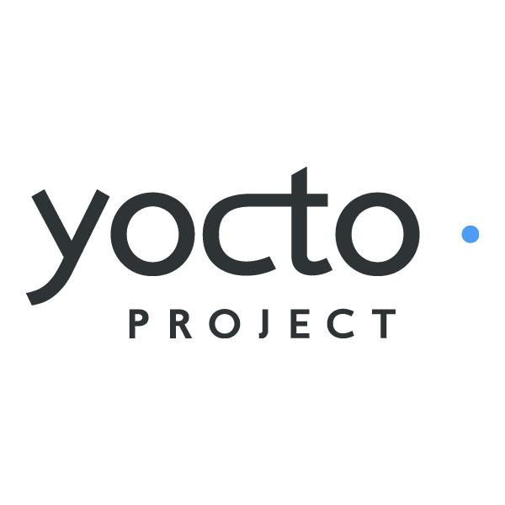

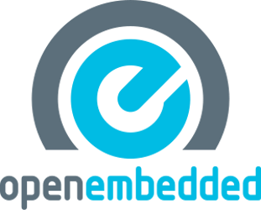
These problems have been solved before
Why reinvent the wheel?
Notes:
JL
Any explicit or implicit favouring or slighting of Linux distributions you may infer from this slide represents only my own opinion, not Nisha’s or VMware’s
Talk and exploration sparked by recognition that Linux distributions were created to build repeatable, identifiable and recent images.
Why reinvent the wheel?
Should at least understand the wheel better before reinventing

Slide 9
Tool usability continuum
...or DevOps
Development
Deployment
Easy to use
Comprehensive
Available
Content
Trusted
Content
Fast
Reliable
Notes:
NK
However, distro tools are notorious for being difficult to pick up by a typical modern app developer (web applications, ML, one golang binary)
Developers/users want ease of use, broadly available content, fast builds
Build/compliance/security folks want hermetic (isolated) builds, secure builds producing secure content, and images with the 3 desirable properties from earlier – repeatable, identifiable and recent.

Slide 10
Investigation
Using distribution tools to build container images
Notes:
JL
We now had an theory/idea - distro tools provide a mechanism for creating images that satisfy the properties we care about. Time to test it.

Slide 11
Linux distributions and tools
Choosing is hard
Debian and DebOS
Debian – the universal OS
DebOS – Debian image generator created for Embedded Linux use-cases
Buildroot
Embedded Linux image creator
Yocto Project
Embedded Linux distribution builder
Guix SD
Functional distro built on Guix package manager, inspired by Nix
Scheme extensions provide DSLs for packaging and configuration
Notes:
JL
Choosing is hard, apologies if your favourite isn’t here.
Picked based on familiarity and gut feeling of which may best satisfy requirements
well established/classical Linux distro
Debian is one of the oldest, continuously maintained, distros
two main embedded tools - because embedded have cared about and addressed these problems for some time
Buildroot is an image creator rooted in STBs
Yocto Project is a distro builder, better affordances for multiple products/images with shared content and upgrade path
functional distro - interesting ideas
Original functional ideas come from Nix, but Guix seemed to move the needle in a way which improves usability
Reuses existing language (albeit an unknown/archaic one)
Same language (and DSLs built on it) throughout system
Single binary/command with clean(er) options (Nix is multiple binaries, confusing/inconsistent options)
Debian:
Strong pedigree
59,000 packages
DebOS -

Slide 12

Distribution tool showdown
Trying to use the tools and compare the outputs
Compare
Ease of use
Output image size
Engineering effort
Quality/presence of SBoM
This Photo by Unknown Author is licensed under CC BY-SA-NC
Notes:
NK can talk about this
Ease of use -> get it up and running with minimal interference

Slide 13
Experiment 1: base OS for Go applications
Base OS with Go toolchain
Goal: create a container image with Go toolchain
DebOS:
Ease of use 😬
Image size 😌
Engineering effort 😎
SBoM 😕
Notes:
NK
Only supported for debian and ubuntu so...Yaml declaration - very similar to Dockerfile but no “layer” consideration
Smaller image than on Dockerhub (understandable because it looks like they build from source - 484MB)
It’s actually quite easy to make this kind of image -> run debos yaml, docker import, docker run -it
SBoM not easy to get

Slide 14

Experiment 1: base OS for Go applications
Base OS with Go toolchain
Goal: create a container image with Go toolchain
Buildroot:
Ease of use 😢
Image size ??
Engineering effort 😖
SBoM 😯
Notes:
Documentation is reasonable to follow - it’s a lot though. You do need a beefy machine for faster builds
You can’t make an image with a golang binary - it seems to depend on some bootstrap mechanism
Couldn’t create image - the basic buildroot image is 1.41MB (+ 14M ~ 16M? Compared to 803M dockerhub image)
Took a really long time to figure this out
Well? If we could do it there seems to be plenty of mechanisms to get your SBoM (--legal-info)

Slide 15
Experiment 1: base OS for Go applications
Base OS with Go toolchain
Goal: create a container image with Go toolchain
Yocto Project:
Ease of use 😫
Image size 😃
Engineering effort 😩
SBoM 🤩
Notes:
JL
YP containers - lots of config options to do so. 136MB image.

Slide 16
Experiment 1: base OS for Go applications
Base OS with Go toolchain
Goal: create a container image with Go toolchain
Guix:
Ease of use 😖
Image size 😤
Engineering effort 😑
SBoM 😕
Notes:
JL
Guix ease of use - no rails, lots of parens. 1.16GB

Slide 17
Status Quo -> Just Enough
Base OS
+
App SDK
+
App
App
+
Dependencies
Current
Ideal
Notes:
NK
Current:
BaseOS + Ecosystem Tooling + target app install
Ideal:
App + App Dependencies + System dependencies
(from discussion on Mon): to get to the ideal, need to talk about packaging
Modern app developers usually create containers the same way they develop (choose OS similar to current OS they’re using + tooling)
If using the distro tool you’ll need to think about what the dependencies of your app are, all the way down to the OS. That means as a modern app developer, you need to have a much deeper knowledge of your app than you have now.

Slide 18
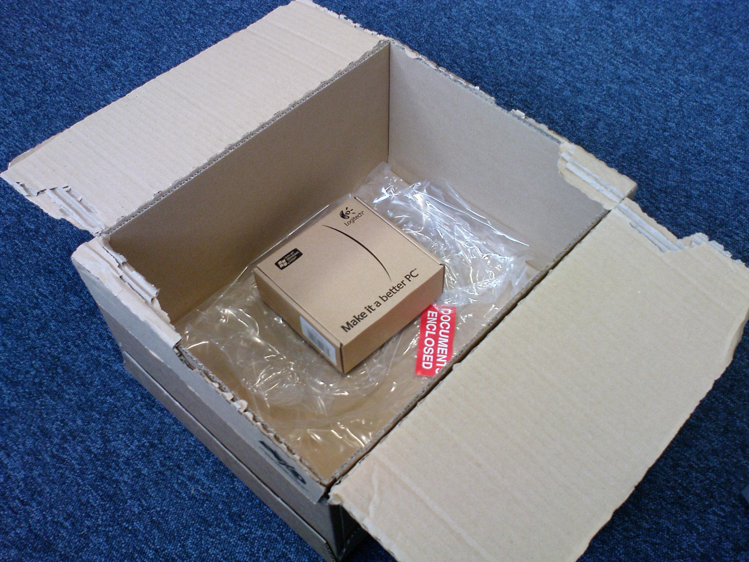
Packaging
Package: describe a piece of software, its dependencies and how to build/install it
Package manager: handles installation and removal of packages (and dependencies)
Notes:
JL
Package is metadata + archive format
Docker images don’t have this metadata describing dependencies
Package manager understands metadata and installs package contents into rootfs
Basis of Linux distros
Basis of Linux distros in the 90’s
Also search, info, etc.
mechanism to distribute Linux & co to users with more sophistication than a series of archives.

Slide 19
Can we leverage the package manager to install only what’s required into an image?
Notes:
JL
classical distro deployments - ensure you have all runtime dependencies of the application when it’s installed
container deployment - use to ensure only the required dependencies of the application are installed into the container?

Slide 20

Experiment 2: Just enough OS (JeOS)
Most container workloads don’t need a full OS root filesystem
Goal: create minimal container image with only the containerised app and its required dependencies.
Notes:
NK - use the tool as a package manager
Docker import and done

Slide 21
Packaging for our target distro tools
My application isn’t packaged
Each distro ecosystem has different packaging and metadata formats and tools to process them.
Tools exist to automate packaging for many Linux distributions and tools
Their support for cloud native languages and frameworks (Go, Bazel, Java, etc) is patchy to non-existent
Automatic packaging tools:
Debian — dh-make / dh-make-golang / gem2deb / pypi2deb
Buildroot — docs for packaging for each ecosystem
Yocto Project — recipetool
Guix — guix import
🧰
Notes:
NK
The tools have their own formula for packaging. Their support for “cloud native” apps is patchy to non-existent
There is a noticeable gap between packaging and using the distro tool to use the then created package.
Debos - no way to install local deb packages; dependencies also need to be debianized
Buildroot - infra learning curve
YP - recipetool ?
Guix - import not supported for golang projects?
The learning curve becomes really steep in this area

Slide 22
What if we could use the native package?
Eg: Postgresql
Base OS
+
Dependencies
+
App
App
+
Dependencies
Current
Ideal
Notes:
JL
Before we advocate for investing time in figuring out packaging software, can we actually achieve the results we want?
For most systems the tools don’t (yet?) support this
Thus, end up using base image + app (& deps through package manager)
That’s smaller in size and less of a footprint/attack surface to maintain than image + ecosystem + app
Debian can install a package into a chroot, but probably missing some transitive dependencies (i.e. certificate store)
How do we convert that chroot into a container image?
Guix pack is awesome!

Slide 23
Summary
Closing remarks
Notes:
JL
We did a bunch of investigation and experimentation, this is ongoing work but for the purposes of this talk we need to provide a conclusion...

Slide 24

Takeaways
This is only a partially solved problem
Tools build for different hardware now need to be adapted for different apps
Projects are working on making the jump to cloud
Compelling reasons to help them (Open Source!)
Documentation
Tests
Use cases
Notes:
NK
App developers can’t/won’t/shouldn’t use them as is
Fedora are working on smaller container images
Many are working on improving auto packaging tools for modern app development - Bazel, Go, etc.

Slide 25
Actionable learning
What can we do today for my Dockerfile built containers?
Introspect your containers: Dive, Container-diff, Tern
Get to halfway
Fairly straightforward to use debos
Make your Base OS + SDK with debos
Use this Base OS for containerization
Glue code needed for Guix
Make the appropriate rootfs from gnu/store
Upstream above improvements to make it seamless
Notes:
Figure out exactly what your Software bill of materials is - hint - it’s not “debian” - use tools to find out
Use the tools to get the image you (mostly) want

Slide 26
Resources
DebOS: https://github.com/go-debos/debos
Debian packaging: https://wiki.debian.org/Packaging/Intro?action=show&redirect=IntroDebianPackaging
Buildroot user manual: https://buildroot.org/downloads/manual/manual.html
Guix user manual: https://guix.gnu.org/manual/en/html_node/
Yocto Project Mega Manual:
https://www.yoctoproject.org/docs/3.0/mega-manual/mega-manual.html
Our Lab Notebook: https://github.com/nishakm/linux-distro-tools
Notes:
NK

Slide 27
Joshua: @hi_joshuagl
Nisha: @nishakmr

Slide 28
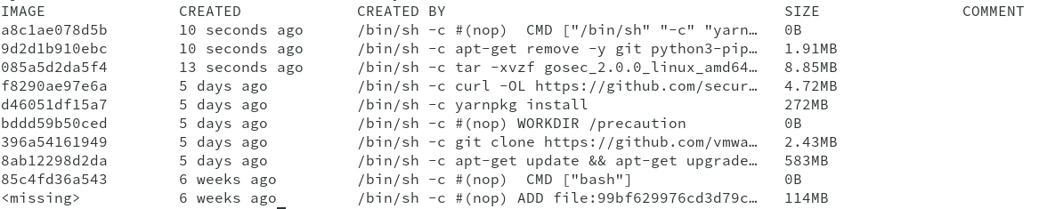
Sidebar: Image layers
Cache invalidation, image size, etc.
Notes:
7 filesystem layers, tarballs!
Changes in an earlier layer (repeatability issues) force the later layers to be rebuilt, even if there’s no logical change.
Almost need a compiler style optimisation pass…

Slide 29
Sidebar: OCIv1 Image Format
Tarballs all the way down
📑
…
📦
📦
📦
📦
Notes:
Detour. Highlight how implementation details can lead to unanticipated occurrences.
Container image is a few manifest files and a tarball for each layer of the image

Slide 30
Sidebar: OCIv1 Image Format
Tarballs all the way down
📦 = 📄
📦 = 📄 📄 📄 📄
📦 = 📄 📄 📄 📄 📄 📄 📄 📄 📄 📄 📄
Notes:
Can’t really delete a file, can only layer over with another file – deleting files makes the image larger! Also means can’t have files beginning with .wh – unexpected…
~= why Dockerfile added multistage builds, can create a single layer image with only the final contents - yet these make preserving the property of identifiability extremely hard because they throw away the early stages

Slide 31
Experiment 2a: packaging Fluentd
Unified logging layer
Debian: 😞
gem2deb requires dependencies be satisfiable by apt
Ergo; need to package dependencies first
Buildroot: 😫
No auto-packaging tools exist for buildroot
Yocto Project: 😩
recipetool doesn’t support Ruby projects
Guix: 😢
guix import has a --recursive option, to also handle dependencies
Still couldn’t build a working package
Why fluentd? (fluentd.org)
Cloud native application (we all ❤️ logs)
Ruby - dynamic languages require more diligence

